Slide 1

Optimal Pricing
TEAM: JORDINA ORCAJO, ANGELA ROCA, ALBA CONDE, ROGER BORRÀS
TUTOR: SANTI SEGUÍ

Slide 2
INDEX
1.

Slide 3
LES DADES: COM SON I COM LES TRACTEM
Punt1
Punt2
...

Slide 4
ESTRATÈGIA EN EL PREU DELS VOLS: ANÀLISI DESCRIPTIU
Punt1
Punt2
...

Slide 5
STRATEGY FOR THE PRICE OF FLIGHTS: modeling and recommendation system
Model pricing fluctuations.
Pricing differences in pricing between operators.
Defining purchasing strategies.
Training a ticket pricing prediction model.
Training a classification model to recommend users to purchase the ticket or not.

Slide 6
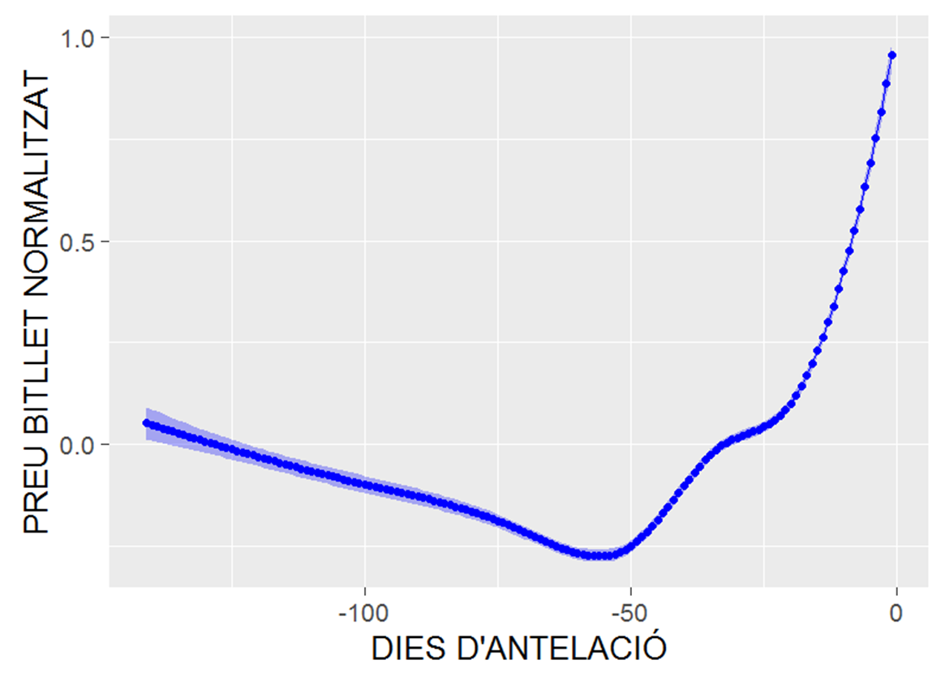
Fig.1 : Local regression of global pricing fluctuation

Slide 7
PRICE FLUCTUATION
Globally, the prices tend to go down, between five and two months.
The cheapest price is on the 55th day before the departure time (8 weeks left).
If we take a global linear approach, the price increases a 0.18 € per day.
Splitting by time, up to the 55th day before the departure, prices tend to fall 0.03 € per day. From that day, the rise is 0.42 € per day.

Slide 8
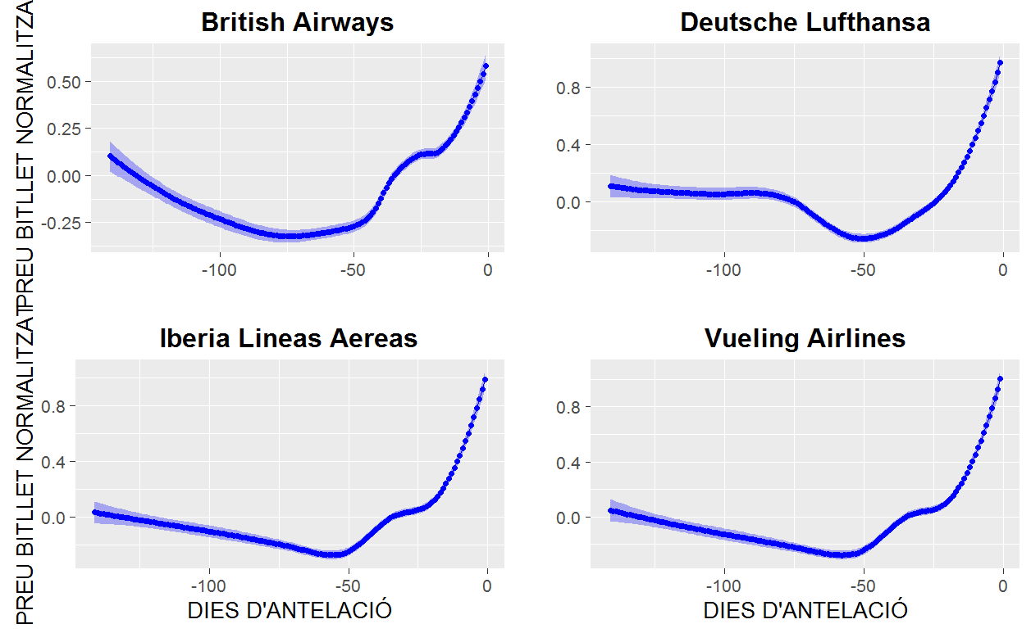
Fig.2 : Local regression of global pricing fluctuation by airline company

Slide 9
PREDICTION OF PURCHASE PRICE
The cheapest day to fly is Wednesday (90 € on average). On Sunday is the most expensive and worth 40 €.
To buy tickets, the best day is Tuesday. And the worst is Sunday worth 4 €.
The days of high demand the prices are 18 € higher.
We train a model to predict the price, with the:
  day of departure
  day of purchase
  the days ahead
  the demand type (high/low)
  the company
  the city of destination
  We obtained an R² of 0.57.

Slide 10
RECOMMENDER
Our recommender will suggest to buy or not to buy.
We create an output variable which tell us if the price will decrease or increase in the future.
We apply different methods with 10-fold cross-validation.

Slide 11
(?)RECOMMENDER - different models
Different accuracy/standard desviation for each model:
  Logistic regression
  Cart
  Random Forest
  Stochastic Gradient Boosting

Slide 12
PART SCRAPPING...
Punt1
Punt2
...

Slide 13
ESTRATÈGIA EN EL PREU DELS VOLS: CONCLUSIONS I FUTURS PASSOS
Punt1
Punt2
...

